Slide 1
Lecture 5 More maximum likelihood estimation
Kristin Privitera-Johnson
FISH 553 Advanced R
School of Aquatic and Fishery Sciences
University of Washington

Slide 2
The Von Bertalanffy Growth model predicts a fish’s length at a specific age.

Slide 3
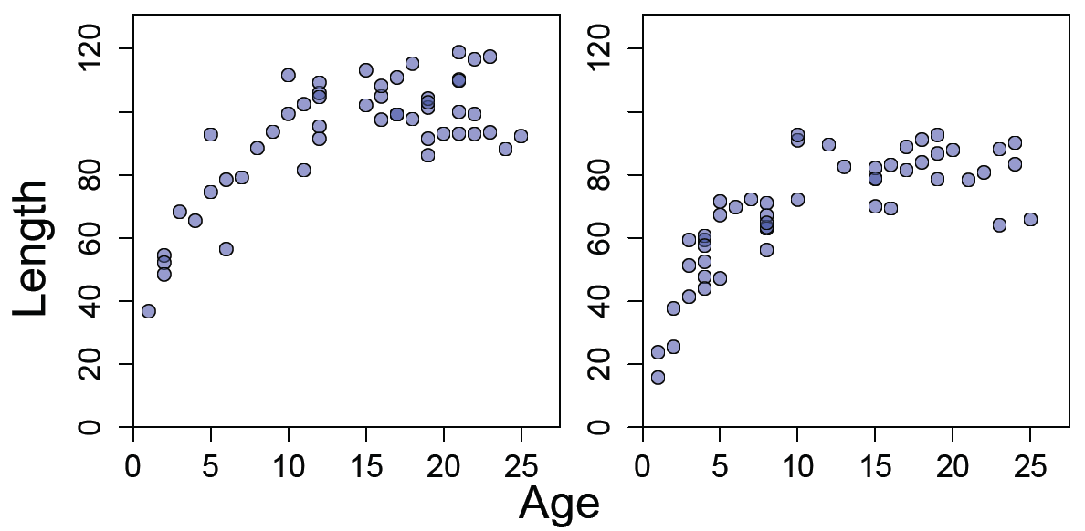
Hypothesis: Von Bertalanffy growth model
Scenario: the length (L) of a fish is related to its age (a) according to the von Bertalanffy growth curve
where is the asymptotic maximum length in cm, K is the growth rate, and t₀ is the age at zero length
~
Males
Females

Slide 4
Questions to answer
~
Research question: Can we conclude that asymptotic length differs for males and females?
Estimate the parameters (L∞, K, σ) for this equation separately for males and females
Calculate 95% confidence intervals for asymptotic length (both male and female)

Slide 5
L∞, K, and σ are the model parameters and their role is to represent our best guess about the processes that created our observed data.
The role of ε is to represent our best guess about the error process involved in the environment and data collection of the observed data.
Error process in the environment == process error
Error process in data collection == observation error

Slide 6
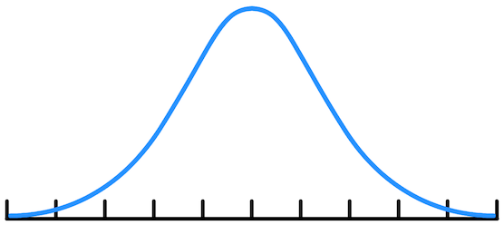
Increasing σ means we assume there is more error
Likelihood
Density
σ
Observed Length
Predicted Length, L_{pred}

Slide 7
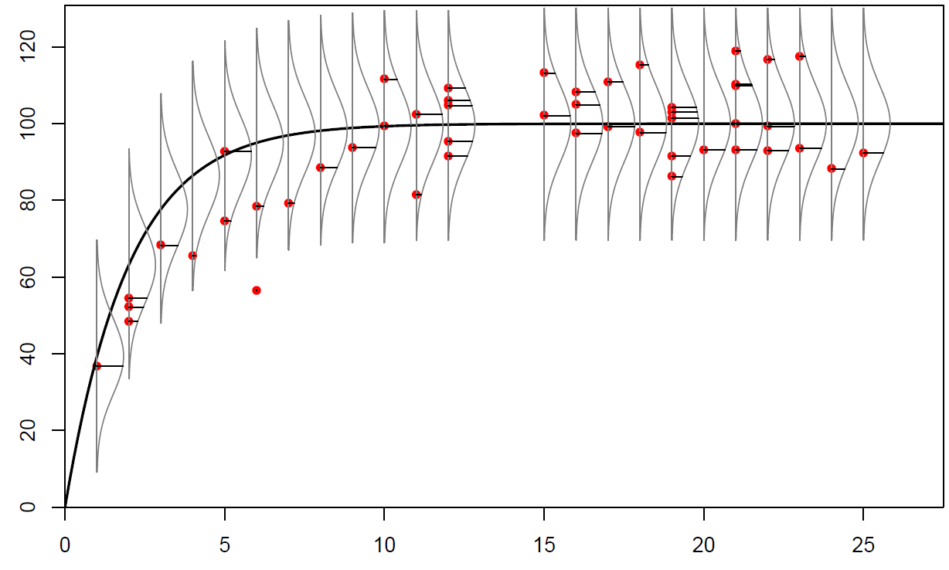
The normal curves on this plot are the same idea as the previous slide. We have turned them sideways and centered them on the model prediction, L_{pred} at various spots along the predicted curve to visualize our model.
Length (cm)
Each curve is a normal distribution with the mean at the model prediction. The height of the curve at each red data point is the likelihood. The likelihood depends on the curve type (normal), the model prediction at that age (mean), the data points, and the standard deviation chosen (σ = 10 here)
Age (years)

Slide 8
Poll

Slide 9
Describe how different values of σ influence how likely the data we observed occurred.

Slide 10
Predict how different values of L∞ and K influence how likely the data we observed occurred.

Slide 11
Finding the maximum likelihood estimate (MLE)
For every data point L_{i,obs}, calculate the likelihood from the normal distribution, given a VB-predicted length L_{i,pred}, and a standard deviation (σ)
The total likelihood of the model fit to the data is the product of each L_{i} value
The maximum likelihood estimates are the values of K, L_{inf}, and σ that result in von–Bertalanffy-predicted lengths L_{i,pred} that maximize the total likelihood
This L is likelihood, not length
Equation for one data point’s horizontal line in the previous plots

Slide 12
Reality: Negative log-likelihood
Products of likelihoods produce tiny numbers, such as 10⁻⁸⁰, that computers don’t handle very well
However, maximum likelihood estimates occur at the same values of K, L_{inf}, and σ as the minimum negative log-likelihood
Start with the normal likelihood
Take the negative log likelihood
The negative flips the curve so we look for a minimum instead of a maximum
The logarithm turns tiny numbers into usable numbers:
-ln(10⁻⁸⁰) = 184
Remember:
ln(a\b)=ln(a)-ln(b)
ln(ab)=ln(a)+ln(b)

Slide 13
Product of likelihood, sum of -lnL
The MLE is where the product of the likelihoods is highest
Now ln(x₁ × x₂×...) = ln(x₁)+ln(x₂)+..., therefore
Simplifying produces this equation
This is the normal negative log-likelihood
This is the sum of squares! Note the residuals here L_{obs}-L_{pred}

Slide 14
Negative log-likelihood
The maximum likelihood estimate (MLE) is where the product of the likelihoods is highest
The MLE is also where the sum of the negative log-likelihoods is the smallest
To answer Question 1, we must find values of , K, and σ that produce L_{i,pred} values that minimize –lnL_{tot}

Slide 15
Coding –lnL in R: three methods
Manually:
NLL <- 0.5*ndata*log(2*pi) + ndata*log(sigma) +
1/(2*sigma*sigma) * sum((lengths-model.predL)^2)
Negative log of product of normal likelihoods:
NLL2 <- -log(prod(dnorm(x=lengths, mean=model.predL,
sd=sigma)))
Negative sum of log of normal likelihoods:
NLL3 <- -sum(dnorm(x=lengths, mean=model.predL,
sd=sigma, log=TRUE))
The preferred way: fast, easy, minimizes bugs

Slide 16
Exhaustive search for minimum –lnL
A vector of L_{inf} values
nLinf <- length(Linfinity)
nK <- length(K)
Sigma <- 10
NLL <- matrix(nrow=nLinf, ncol=nK, byrow=F)
for (i in 1:nLinf) {
for (j in 1:nK) {
model.predL <- Linfinity[i]*
(1-exp(-K[j]*ages))
NLL[i,j] <- -sum(dnorm(x=lengths,
mean=model.predL,sd=sigma,log=TRUE))
}
}
filled.contour(x=Linfinity, y=K, z=NLL)
A vector of K values
Fix sigma (should loop over sigma too)

Slide 17
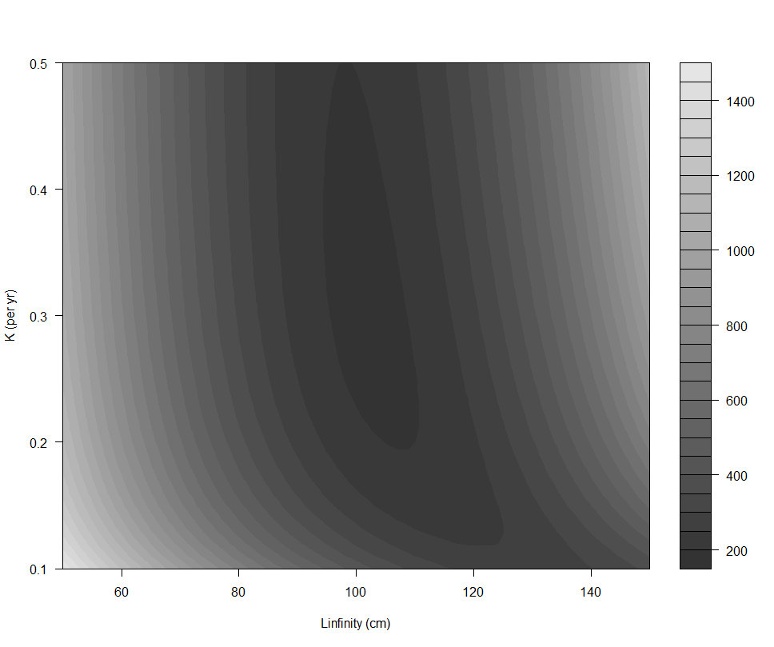
Surface of negative log-likelihood (fixed σ = 10, using filled.contour)
-lnL
K (per yr)
L_{inf} (cm)

Slide 18
What is optimization?
Optimization involves finding the values for the parameters of a function so that the function itself is minimized (or maximized)
Mathematically:
For us, the function f will be the negative log-likelihood
For optimization we can use optim() in the base package or mle2() in the bbmle package
The main focus here will be on mle2()

Slide 19
Using mle2() to minimize functions
mle2(minuslogl, start, method, fixed, lower, upper)
Key arguments (there are many more)
minuslogl: function to minimize, must return negative log likelihood (it ends in an "el" not a "one")
start: list of named starting values of parameters to minimize
method: method to use for minimization; "Nelder-Mead", "BFGS", "CG", "L-BFGS-B", "SANN", or "Brent"
fixed: list of fixed parameters (data)
For the "L-BFGS-B" method you can also specify
lower: lower bounds for parameters (including –Inf)
upper: upper bounds for parameters (including Inf)

Slide 20
Simple example
minim <- function(x, y) {
result <- (x-3)^2 + (y-4)^2
return(result)
}
> mle2(minuslogl=minim, start=list(x=4, y=5))
Call:
mle2(minuslogl = minim, start = list(x = 4, y = 5))
Coefficients:
x y
3 4
Log-likelihood: 0

Slide 21
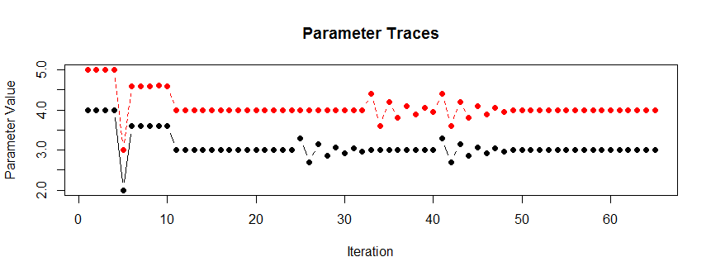
What is mle2 doing?
A trace is the parameter values at each iteration
These traces show us the behavior of the optimizer.
What is it doing? [Finite differences, big jumps]

Slide 22
Von Bertalanffy –lnL function
VB.NLL <- function(Linfinity, K, sigma) {
gender <- "Male"
LA <- read.csv(file="LengthAge.csv")
ages <- LA[LA$Gender==gender,]$Ages
lengths <- LA[LA$Gender==gender,]$Lengths
model.predL <- Linfinity*(1-exp(-K*ages))
ndata <- length(ages)
NLL <- -sum(dnorm(x=lengths,
mean=model.predL,sd=sigma,log=TRUE))
return(NLL)
}
> VB.NLL(Linfinity=100, K=0.2, sigma=10)
[1] 202.9833

Slide 23
In-class exercise 1
Download the code from “5 VB NLL.r" for the VB.NLL() function from the previous slide and download "LengthAge.csv" from the website
Use mle2() (package bbmle) to find values for Linfinity, K, and sigma that minimize the negative log-likelihood for VB.NLL(), for males
Change the code to minimize the function for females
Use different starting values and different methods... some may not get the best answer

Slide 24
What about mle2 and data?
VB.NLL2 <- function(Linfinity, K, sigma, gender,
filename) {
LA <- read.csv(file=filename)
ages <- LA[LA$Gender==gender,]$Ages
...
}
mle2(minuslogl=VB.NLL2,
...,
data=list(gender="Male",
filename="Data//LengthAge.csv"))

Slide 25
Questions to answer
~
Research question: Can we conclude that asymptotic length differs for males and females?
Estimate the parameters (L∞, K, σ) for this equation separately for males and females
Calculate 95% confidence intervals for asymptotic length (both male and female)
[DONE]

Slide 26
Using the optim() function
mle2 is based on optim(), which is called somewhat differently
All arguments that are being varied need to be in a vector, other arguments can be as before
VB.NLL3 <- function(params) {
Linfinity <- params[1]
K <- params[2]
sigma <- params[3]
When calling optim(), it requires vectors (not lists) of parameter values, lower, upper, etc.
optim(fn=VB.NLL3, par=c(100, 0.2, 10))

Slide 27
In-class exercise 2
Modify the code for the VB.NLL() function, renaming it VB.NLL3() and use optim() to minimize the function for males and females

Slide 28
What about optim and data?
VB.NLL4 <- function(params, gender, filename) {
Linfinity <- params[1]
K <- params[2]
sigma <- params[3]
...
}
optim(fn=VB.NLL4,
par=c(100, 0.2, 10),
...,
gender="Male",
filename="Data//LengthAge.csv")
Confusingly, gender and filename are added to the optim() function call as if they were parameters of optim!

